Slide 1
Task 1
Web Scraping

Slide 2
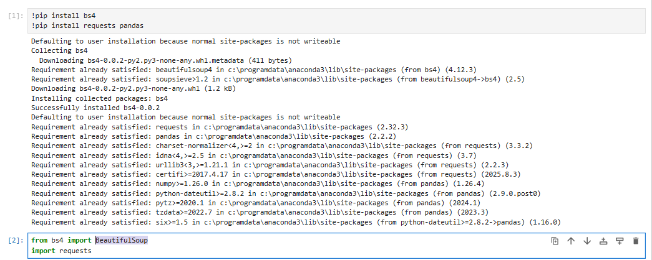
Libraries : Pandas BeautifulSoup

Slide 3
Create Datasets

Slide 4
